Slide 1
Internship at Q-PAC
Ezekiel Dumuk, Engineering Academy, Creekside Highschool

Slide 2


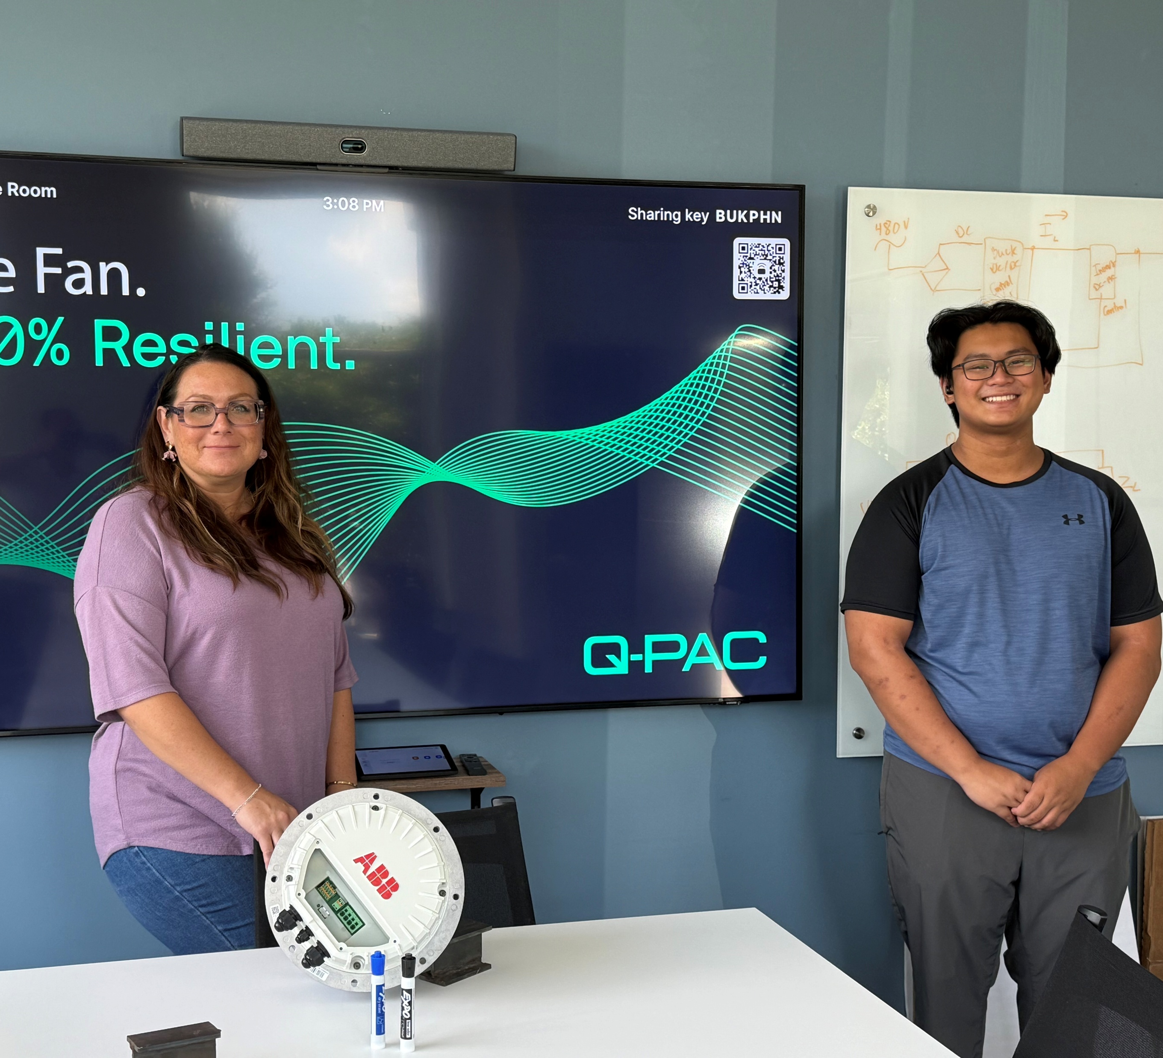
Business Worked At: Q-PAC
The Message? : “We Believe Airflow Should Be Simple”
Q-PAC is the airflow fan company that I interned at where they focused on creating a “revolutionary new commercial air handler fan that fits anywhere, sets up fast, and runs like a dream”

Slide 3
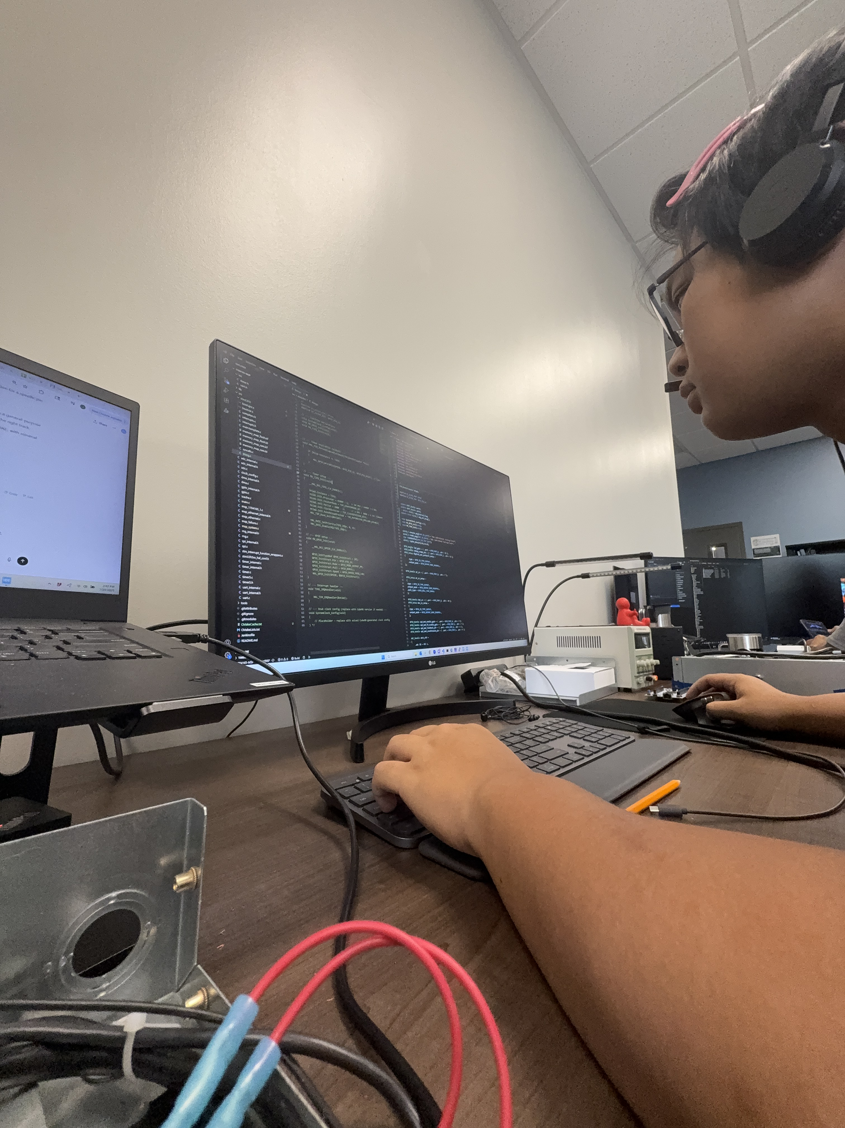
Fan Controller Project
The project I selected was to code the Q-PAC fan controller so that it can run a simulated watchdog timer for the microcontroller inside the fan so that whenever the software for the different layers of code would fail, my code would essentially let everyone whose working on it that something has gone wrong and there is a technical problem.
I first had to learn basic programming in C in order to get started, which then I transferred my skills to a STM NUCLEO microcontroller and then finally applying and figuring out where to fit in my code in the actual fan controller

Slide 4
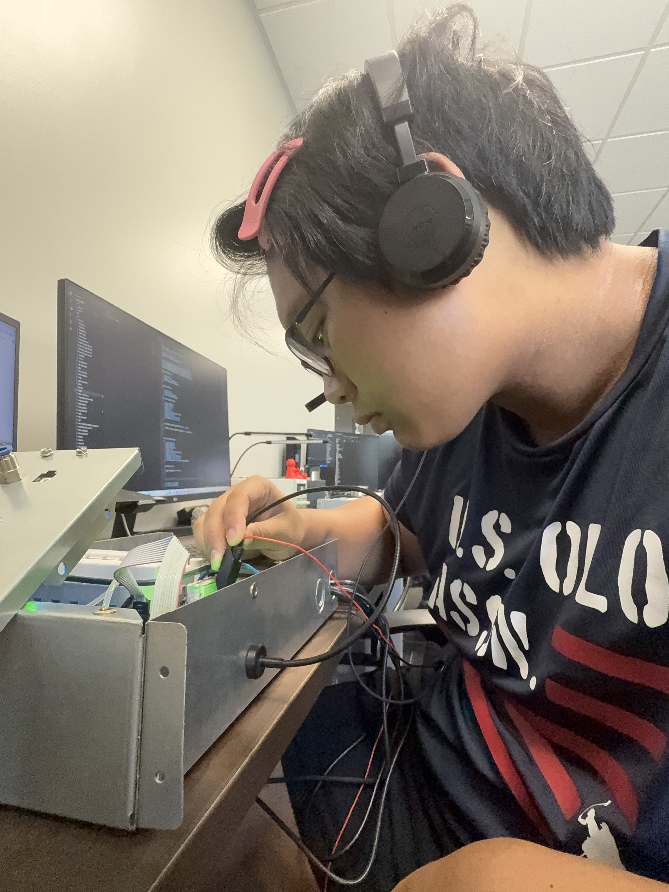
Fan Controller Project Continued
After finally getting the hang of how the programming language and the microcontroller worked, I then transferred to working my code on the main microcontroller in which I had to find the correct layer of code to put it in and then build the code, then run it.
After correctly applying and checking if my code was good and runnable, I had to use a multimeter on the precise pin that I coded for to maker sure the pin was always set to HIGH at 3.3 volts to ensure success of my code

Slide 5
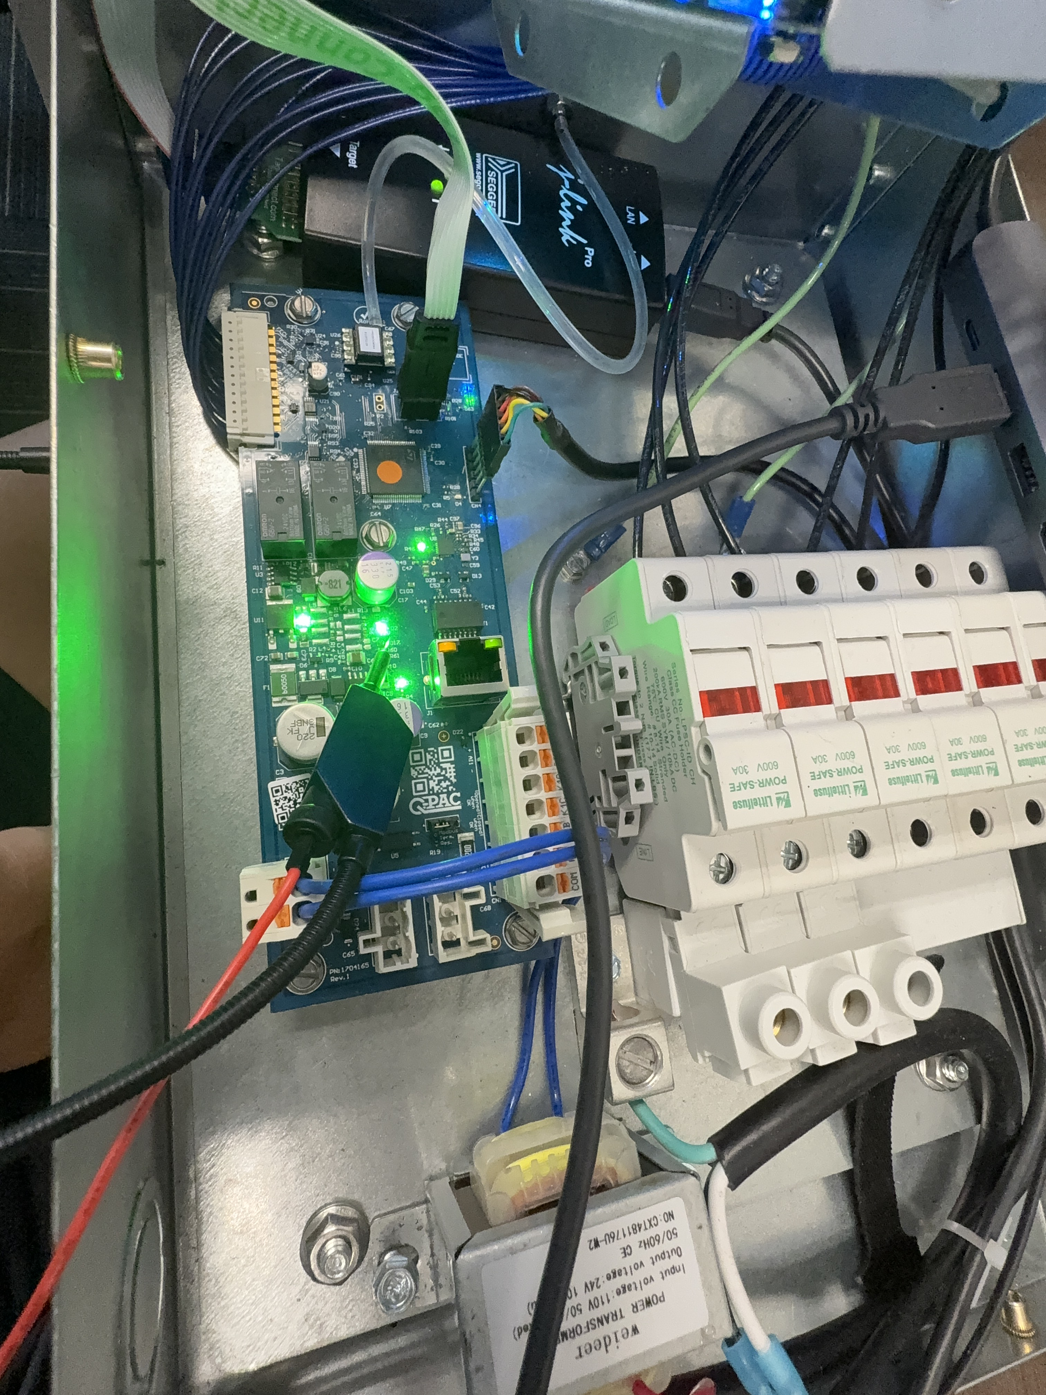
Applied Skills
In the little time I spent in the actual factory part of the facility, I noticed lots of things that came from my training in the engineering academy from when I was getting certified in MSSC Safety and OSHA such as all the different types of PPE available and which ones we had to wear in each zone, and how the basic safety and evacuation systems fell into place incase something went wrong.
And the microcontroller I used to simulate my code was similar to the Raspberry Pi machines that we would sometimes play around with in class
And during that time, I learned so much more than I ever thought I would. As a guy who never coded in his life before, I learned how the fundamentals of C worked, and I learned about how I could use different systems to generate proper code that I could use, I also learned how the different layers of the fan controller layered on top one another to run effectively including some real life software engineering platforms like GitHub and Cube and CLion worked and even applied and used some of those programs in my projects

Slide 6

Plans For After Highschool
As of now, I plan to either go into nursing or engineering in college for my career choice. After working for two months at Q-PAC, it opened my eyes to what real engineering was like, it gave me the experience and real world application I needed. While still undecided on my major, the internship shifted my views a bit more towards the engineering side.
Special Thanks to all of my coworkers in the firmware side who helped and guided me through all the ups and downs of my learning!

